Slide 1
MTN-016 TRAINING Infant HIV Testing
Urvi M Parikh, Ph.D.
University of Pittsburgh
Pittsburgh, PA
USA

Slide 2
An infant should be tested for HIV infection in MTN-016…
If the infant’s mother:
Is known to be HIV-infected
Is newly diagnosed with HIV infection
Is HIV infected and breastfeeding
Requests it
If there is suspected exposure to HIV

Slide 3
WHEN can an infant be tested for HIV infection in MTN-016?
At a scheduled visit
Month 1
Month 6
Month 12
At an interim visit
6 weeks
6 months + 2 weeks
12 months + 2 weeks
Refer to the “Flow Chart for Testing HIV Exposed Infant within MTN-016”
MTN-016 SSP

Slide 4
Testing HIV Exposed Infant within MTN-016

Slide 5
HOW should an infant be tested for HIV infection in MTN-016?
DNA PCR
RNA PCR
Do not use:
HIV Rapid Test
HIV Western Blot
Refer to the “Algorithmn for Infant HIV Testing”
MTN-016 SSP
Appendix 12-2
Page 12-11

Slide 6
START
Sample 1
DNA PCR
(cell pellet)
Algorithm for Infant HIV Testing
STOP
If baby has continued exposure, redraw at a later date
Negative
Positive
Sample 1
RNA PCR
(plasma)
Notify MTN NL
<400 copies
≥400 copies
Sample 2
RNA PCR
Confirmatory and
resistance testing
Notify MTN NL
<400 copies
≥400 copies
Infant is HIV infected.
Schedule for counseling

Slide 7
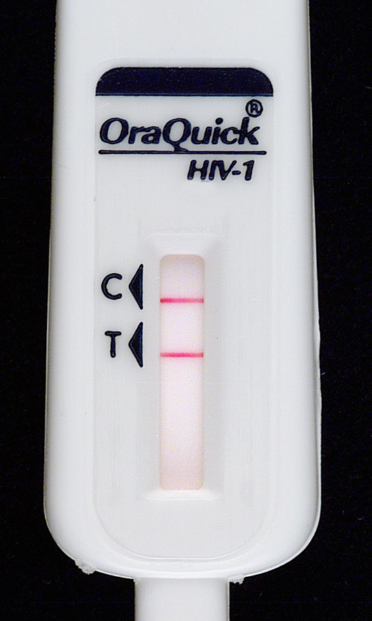
Why are there different HIV tests for infants?
ANTIBODY TESTS
Rapid Tests and Western Blots
Used for HIV testing in children (over 18 months of age) and adults
Antibody based - tests look for the body’s reaction to the virus
Infants still have their mother’s antibodies
All HIV-exposed infants will be “positive” on antibody tests.

Slide 8
Why are there different HIV tests for infants?
NUCLEIC ACID TESTS
DNA PCR and RNA PCR
For infants up to 18 months of age
Must look for the virus itself
DNA PCR – Tests for presence of HIV genetic sequence in cells
RNA PCR – measures how much virus is in the blood (viral load)

Slide 9
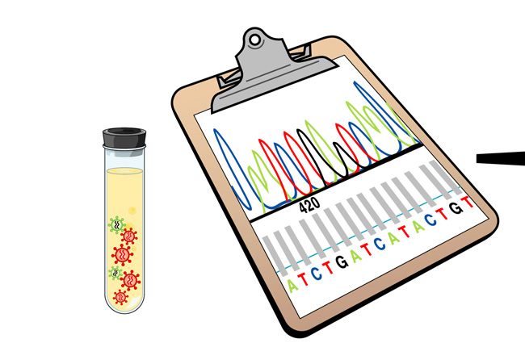
What other tests will be done for an HIV-positive infant?
Standard genotypic resistance testing
Sensitive resistance testing to identify any mutations that are not detected by standard testing
Why check for drug resistance?
Mother may have been exposed to ARV through study product or PMTCT when giving birth.

Slide 10
Coordinating mother and baby study visits if both are positive
If mother is…
Not enrolled in MTN-015
If eligible → offer enrollment
If not eligible → test baby as scheduled
Is enrolled in MTN-015
Try to schedule mother and baby at the same time if feasible
Will be helpful for monitoring drug resistance

